Slide 1
HR ANALYTICS DASHBOARD
GROUP-:6
SAMBIT KUMAR BEHERA
ADITYA BALASAHEB GITE
MANISHA RAI
RAHUL MUDALAGI

Slide 2
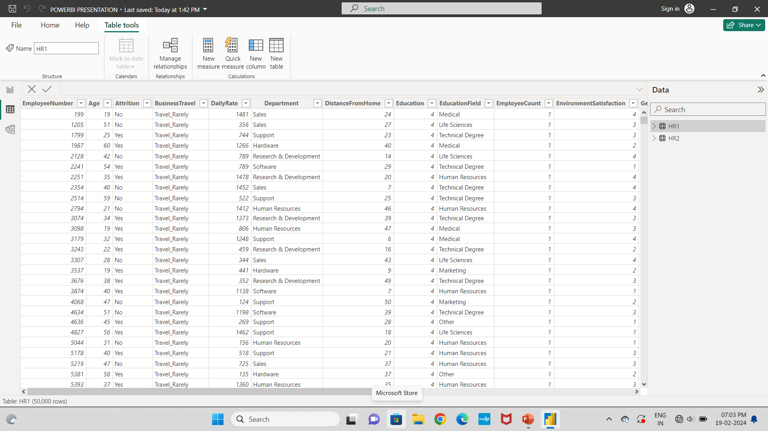
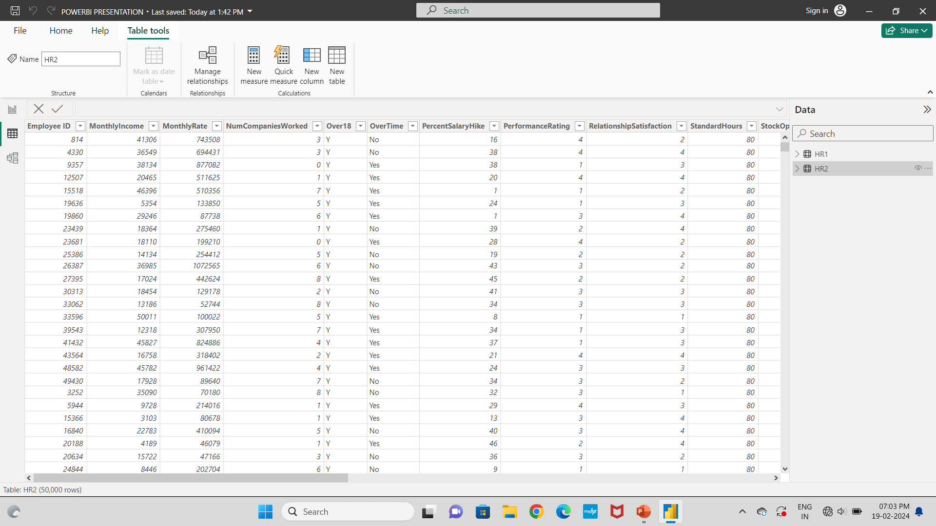
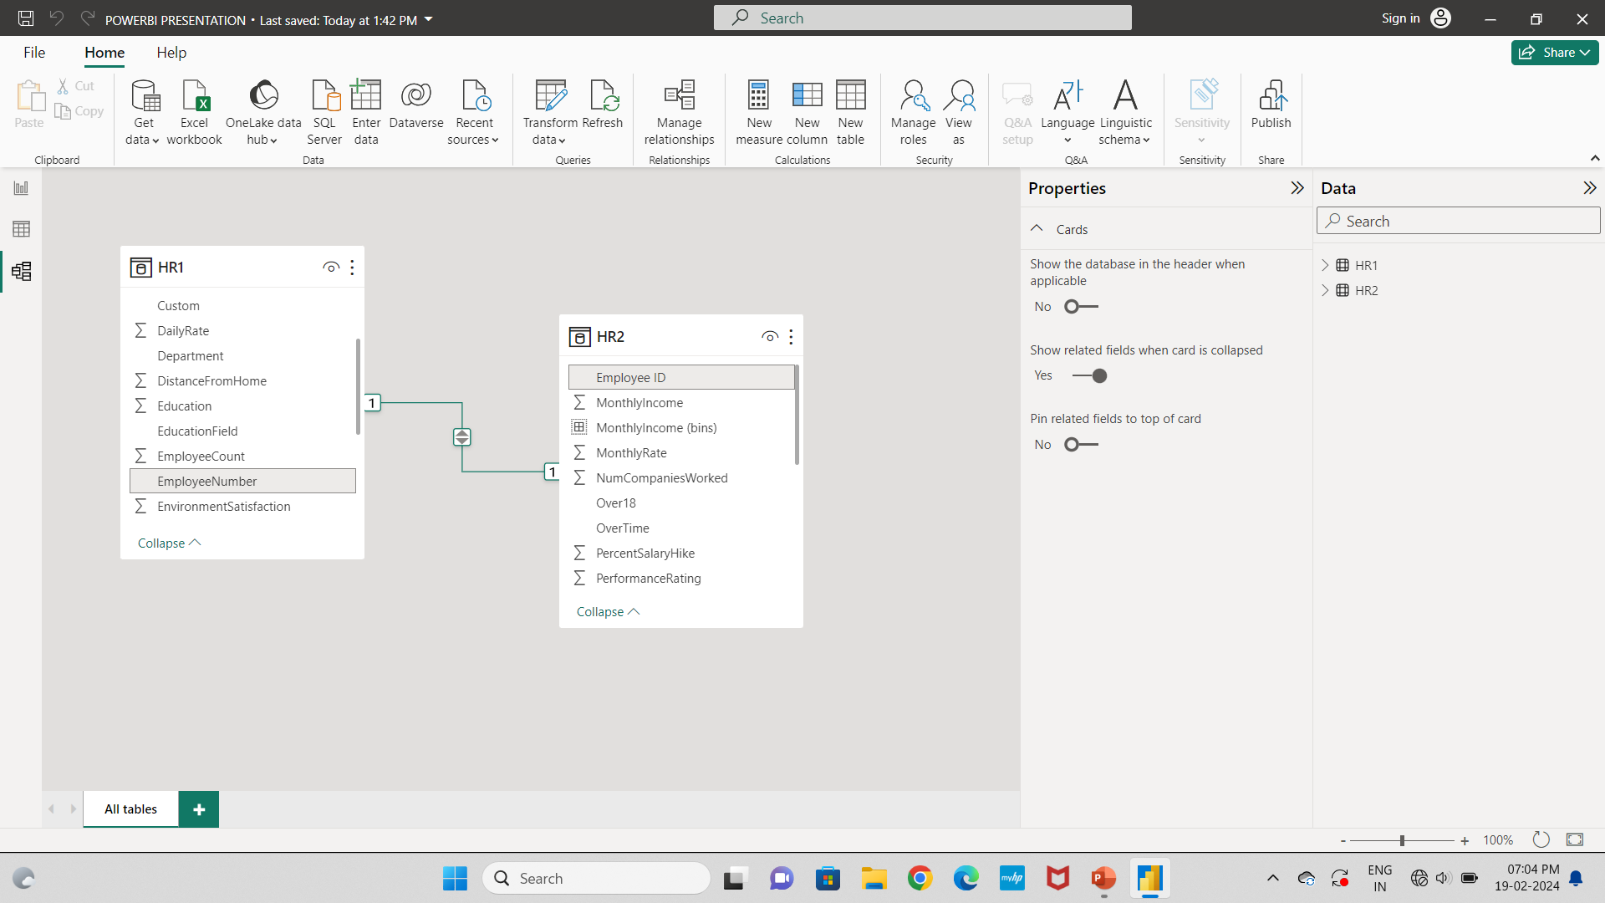
As We Received Data Set HR1 & HR2 Data Set Which Contains Both 50000 Data
So We Have To Upload Them In PowerBI And Link All Common Data

Slide 3
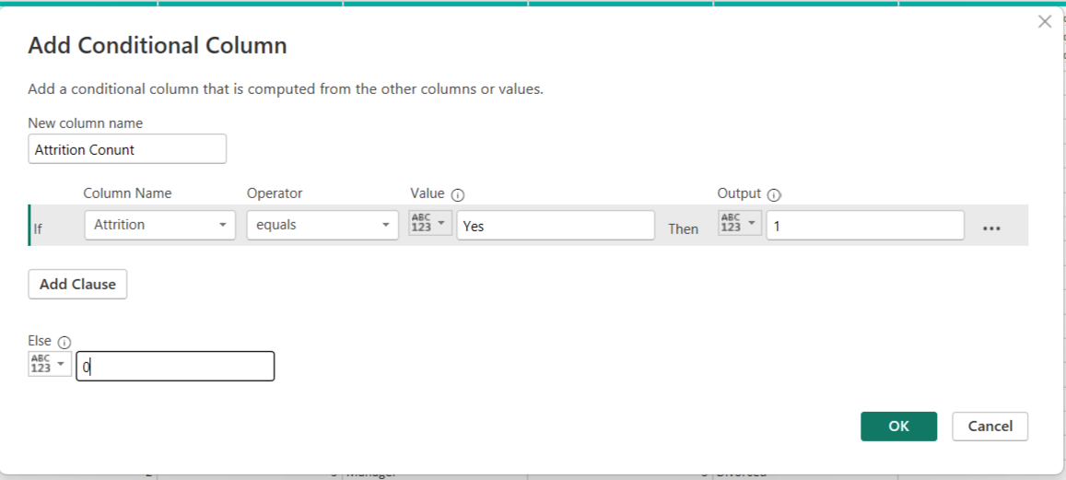
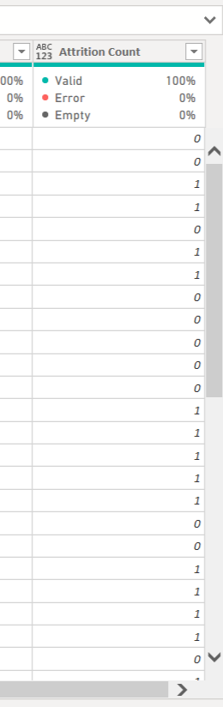
As per our requirement we create some measure & Conditional Columns
First We Create One Conditional Column For How Many Employee Leave The Organization
As Our Data Set for Attrition it will show in yes/no format but for counting we have to set it to number format.

Slide 4


We Create Some Measure For Our Dataset Here It is
For Information About How Many Employee Still Working In Company We Create one Measure
For Information About Attrition Rate We Create Another measure

Slide 5
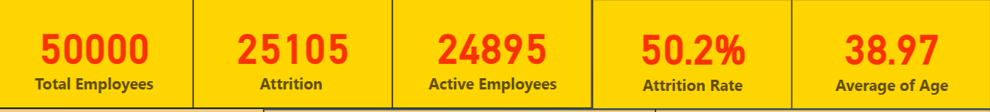
As Our Data Set We Create 5 Card View For Dashboard
We Insert Total Employee in field and change it into Count.
We Insert Attrition Count In Field.
We Insert Another New Measure Which Is Attrition Rate into the Field
We Insert Age Into The Field And Change It Into The Average
We Insert New Measure Which is Active Employee put it into the field.
After Creating All The Card We Will Design In Our Own As We Can See We Change Font Size And Letter, Change the Category label size etc.

Slide 6
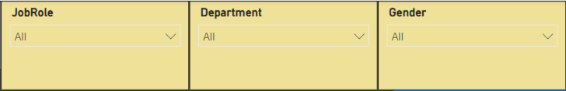
After All We Put 3 Slicer In Our Dashboard
In Slicer We Put JobRole, Department & Gender Respectively And change in slicer setting style to dropdown

Slide 7
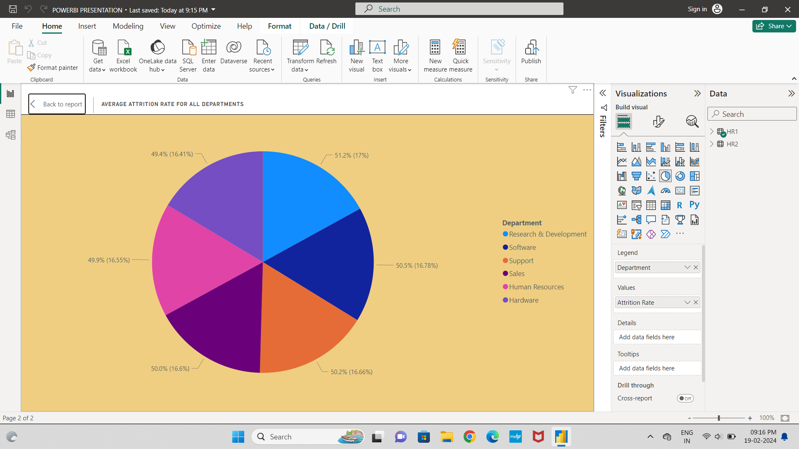
Our 1st kpi which we created is Average Attrition rate for all Department
We take Pie chart for this in values we put attrition Rate measure & in legend we put department
As we can see research & development has highest attrition rate 51.2 rate which occupied 17% of pie chart followed by software, support etc & Hardware has lowest attrition rate 49.4 which occupied 16.41% of pie chart.

Slide 8
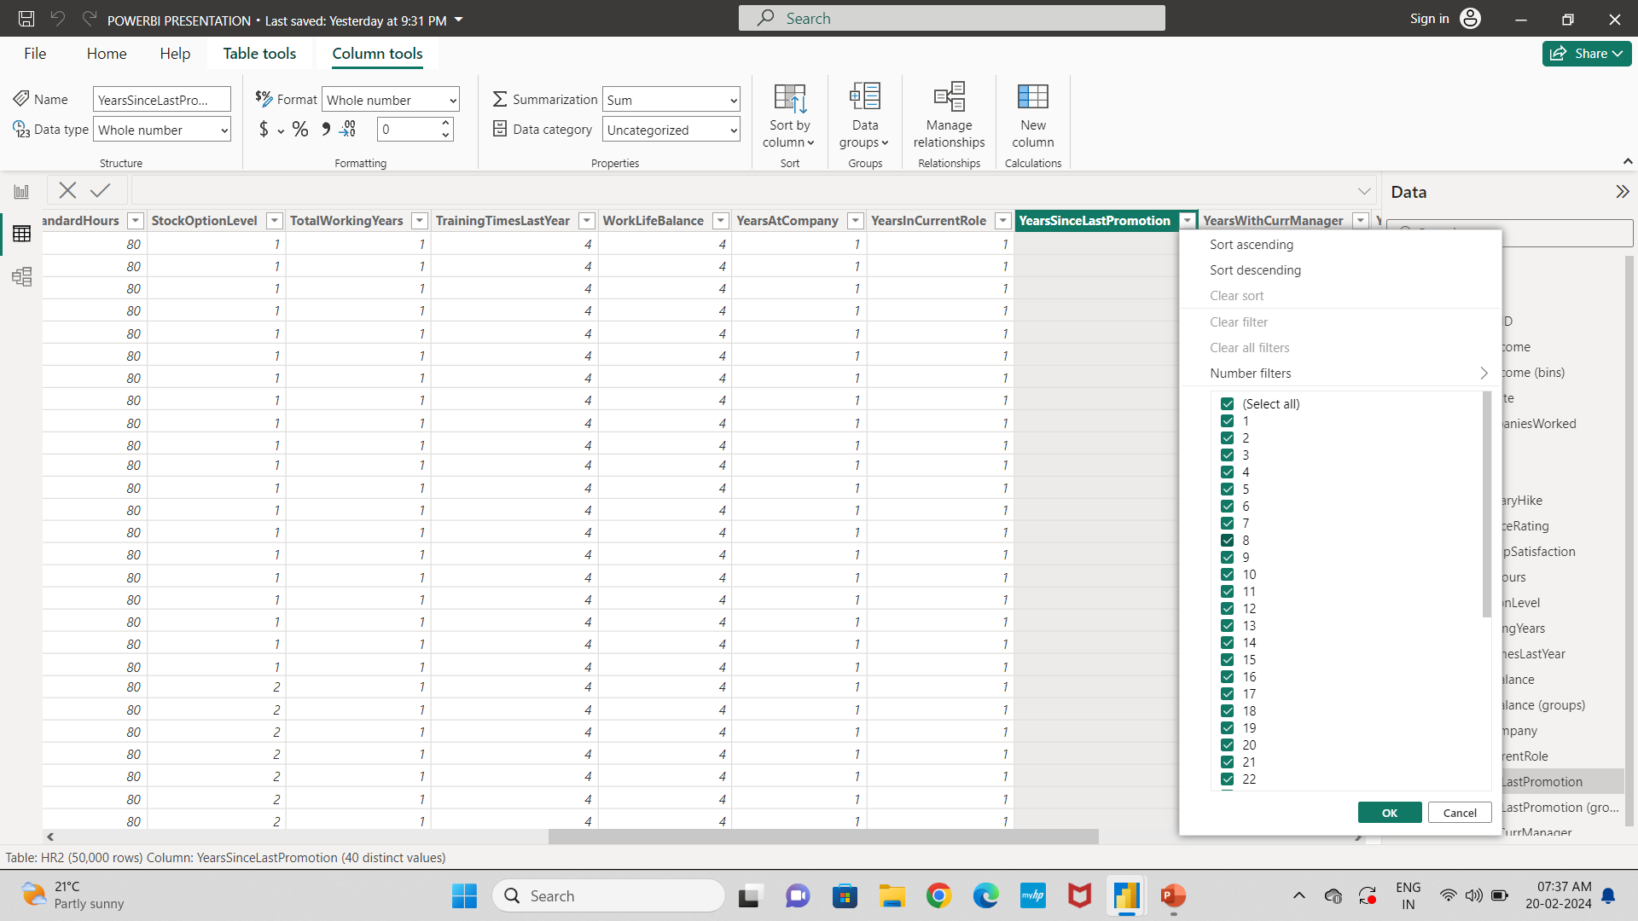
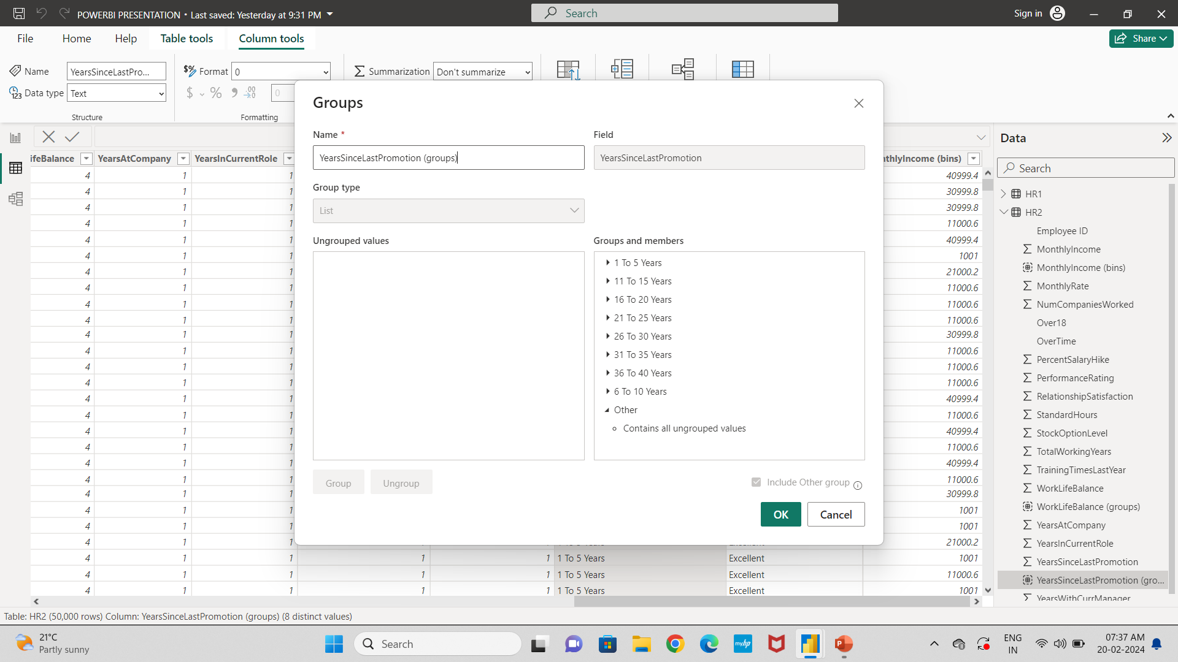
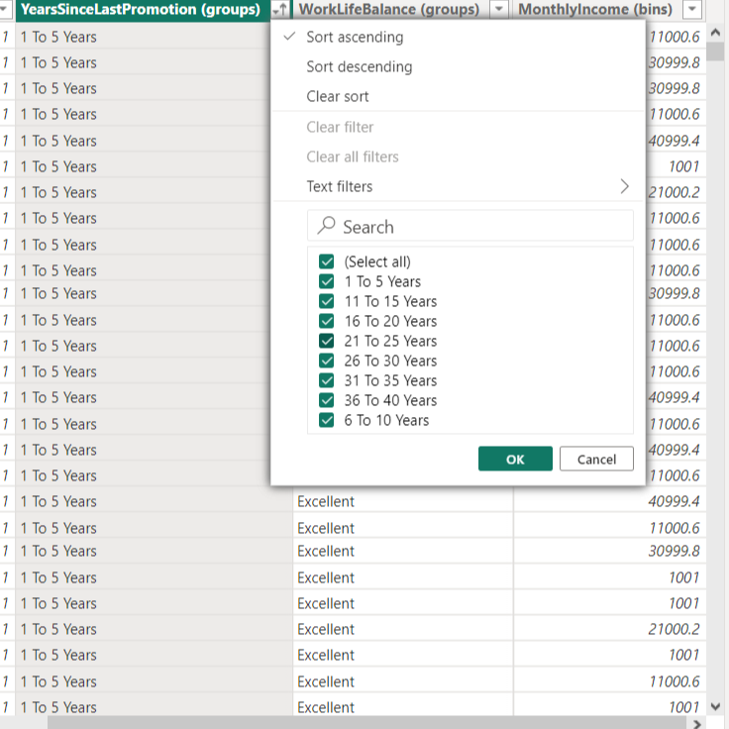
Our 2nd kpi is Attrition Rate vs Year Since Last Promotion
After Creating Groups Like This
We Have A column Like This.
As Our Data Set We Have Year Since Last Promotion In Individual format So First we create a group of Number Of Years.

Slide 9
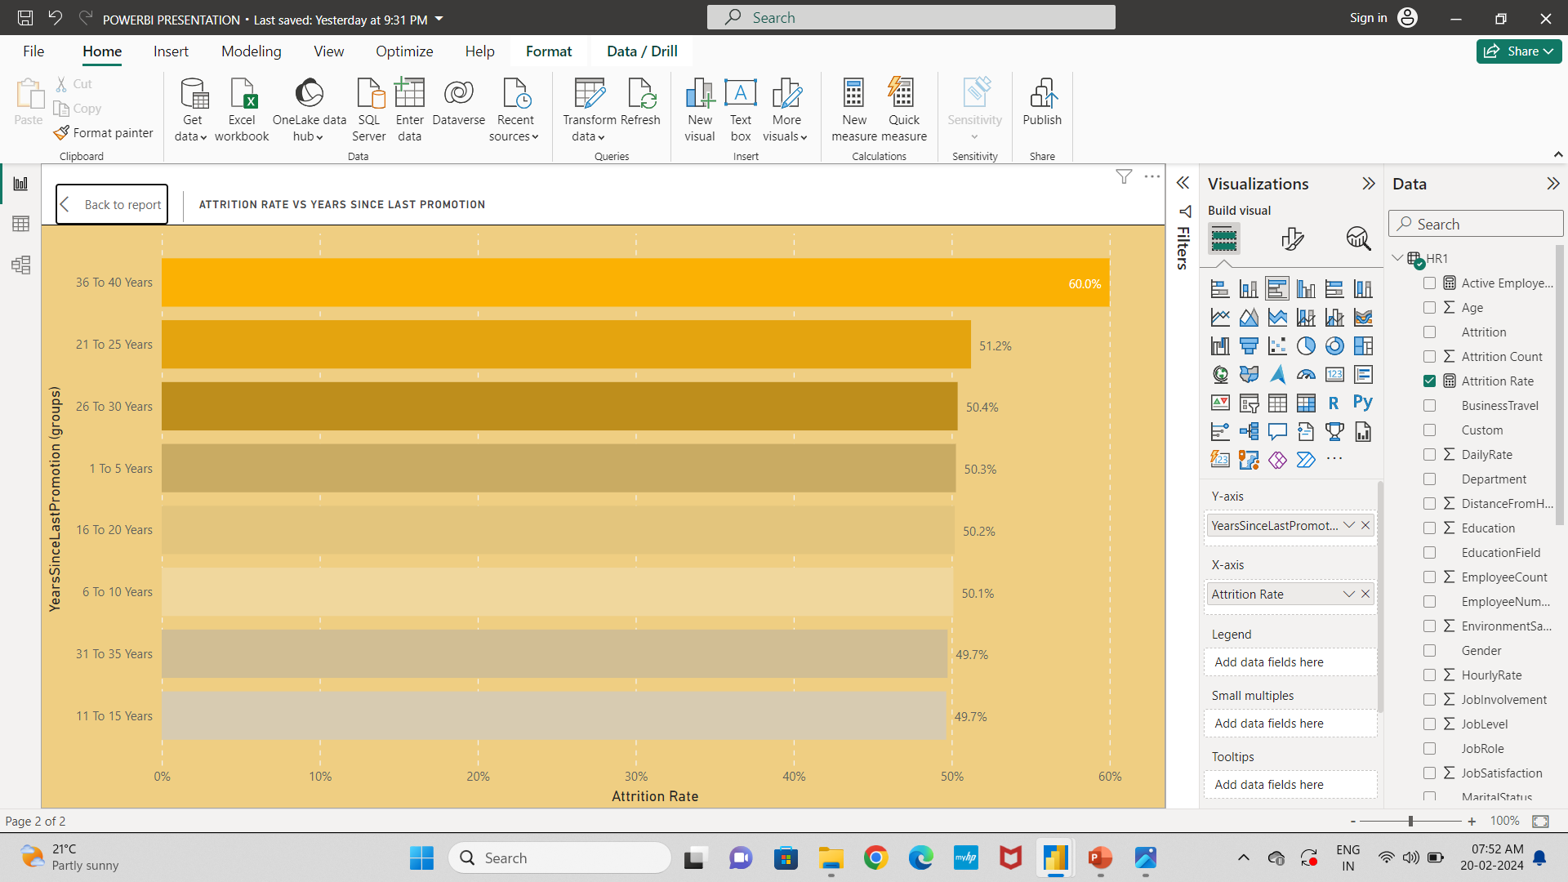
So, We Take One Clusterd Bar Chart In Y Axis we Put Year Since Last Promotion Group Which We Have Been Created And Attrition Rate In X Axis
As We See 36 To 40 Years Bar Exceed The Average Bar Which Is 60% And 11 To 15 Years Below The Average Bar Which Is 49.7%

Slide 10
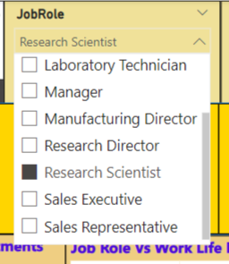
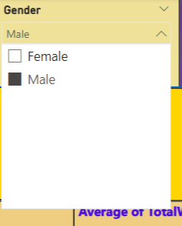
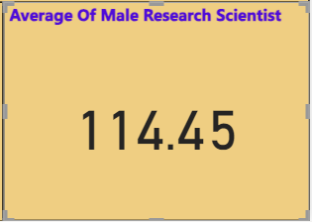
Our 3rd KPI Is Average Hourly Rate Of Male research Scientist
First We Take Card View For This In Field We Insert Hourly Rate And Change it Into Average
As We See In Job Role Slicer We Select Research Scientist And In Gender We Select Male
As We See The Result Of Average Of Male Research Scientist Is 114.45

Slide 11
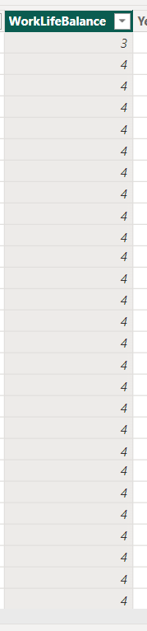
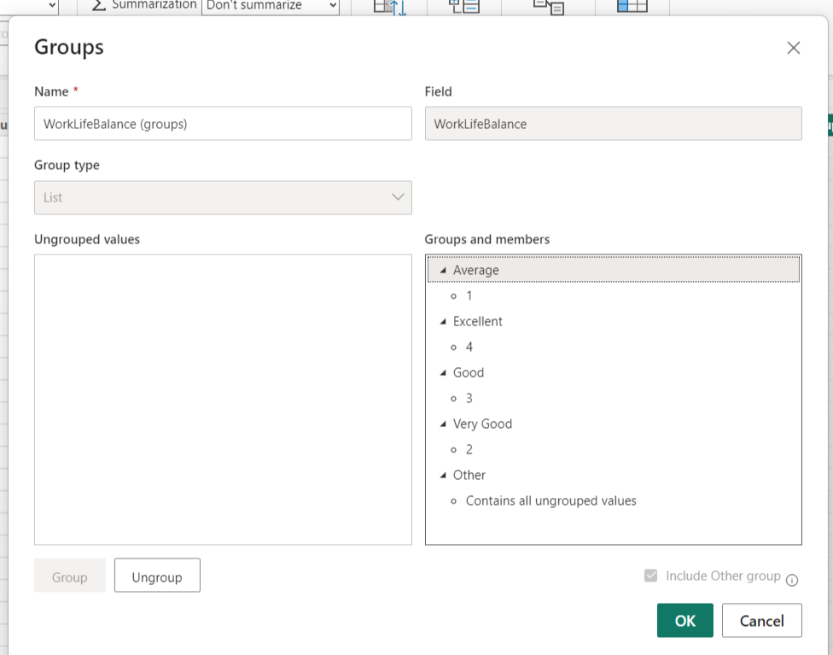
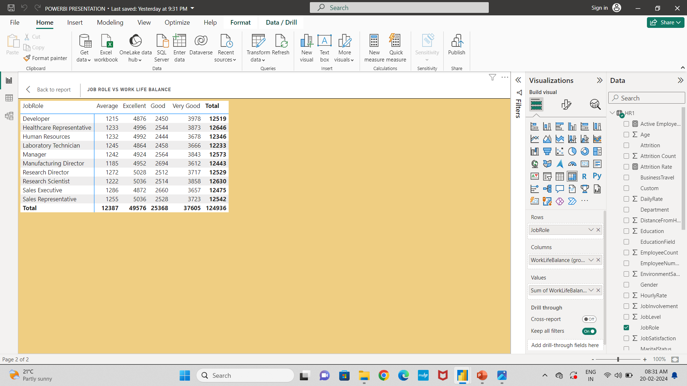
So Our 4th KPI is Job Role Vs Work Life Balance
So As Our Data Set We Have Work Life Balance In Number Format
We Created A Group Of Work Life Balance Like for 1 Year we set Average For 2 Year we set Good And for 4 Year We set Excellent.
After Done That We Take Matrix Chart For this In Rows we take Jobrole and in columns we take New group work life balance group which we have created & Then put work life Balance in Value

Slide 12
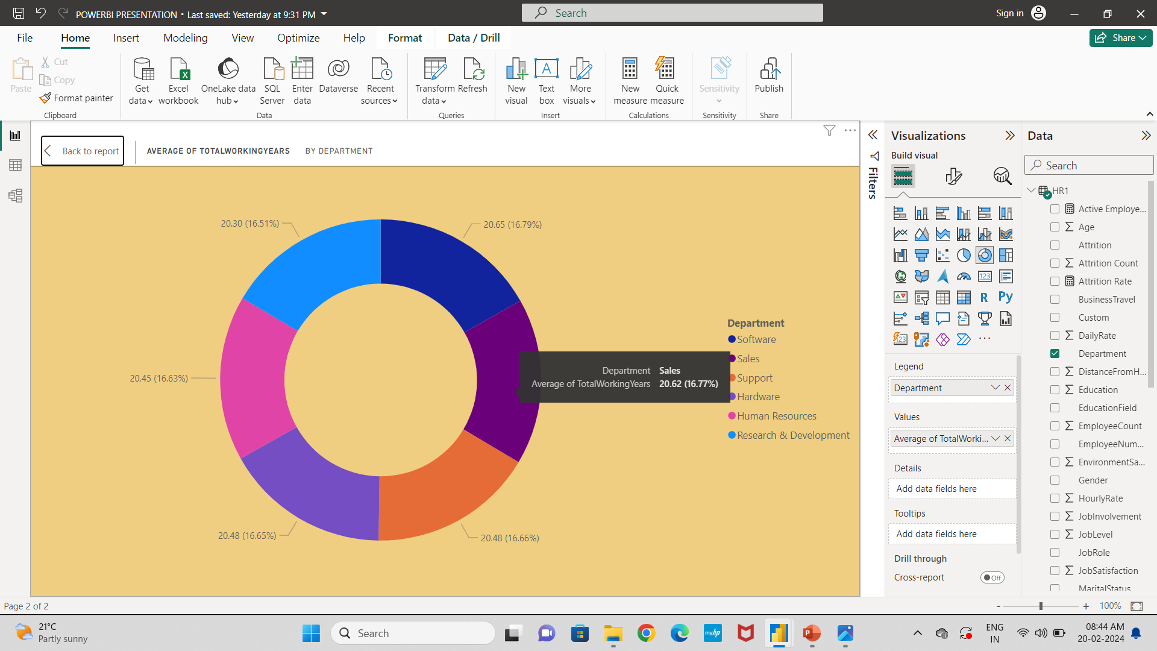
Our 5th KPI is Average Of Total Working Years By Department
So We Take One Donut Chart For This In Legend We Insert Department & In Values Insert Total Working Years and Change it into Average
As We Can See Software Has Highest Working Years as Compare to Other Department Which Is 20.65 And It Occupied 16.79% Of Donut Chart
And Research Development Has Lowest Value which is 20.30 And It Occupied 16.51% Of Donut Chart.

Slide 13
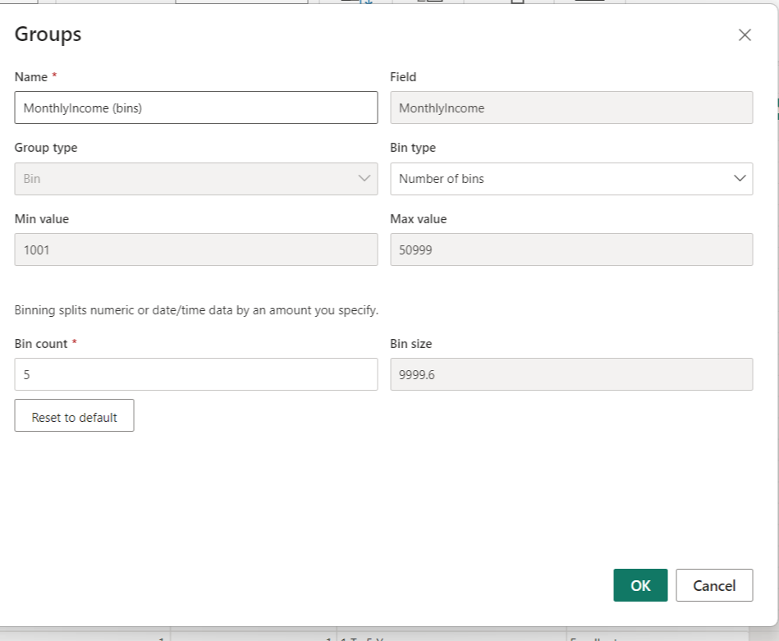
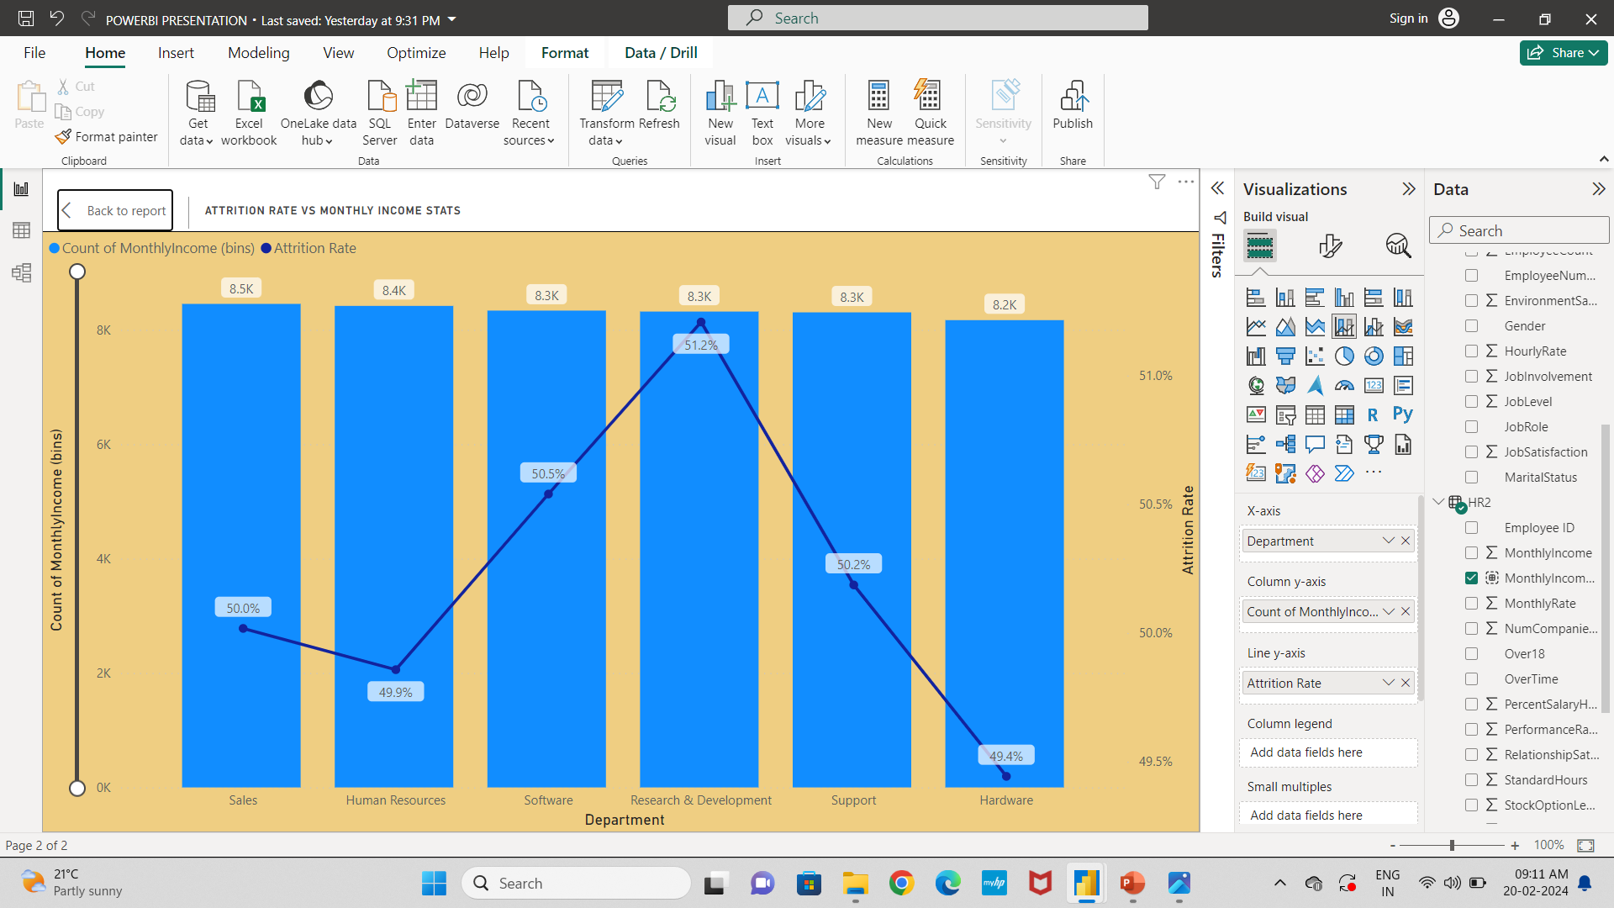
Our 6th KPI is Attrition Rate Vs Monthly Income Stats
As Our Data Set We Created A Group of Bin Monthly Income And Set 5 Bin it automatically Set Bin Size 9999.6 Which Is 10000 Salary per bin approx
After Creating That Bin We take Line and Stacked Column chart in X axis we take Department And Column Y Axis We Take Newly Created Monthly Income Bins And In Line Y Axis We Take Attrition Rate

Slide 14
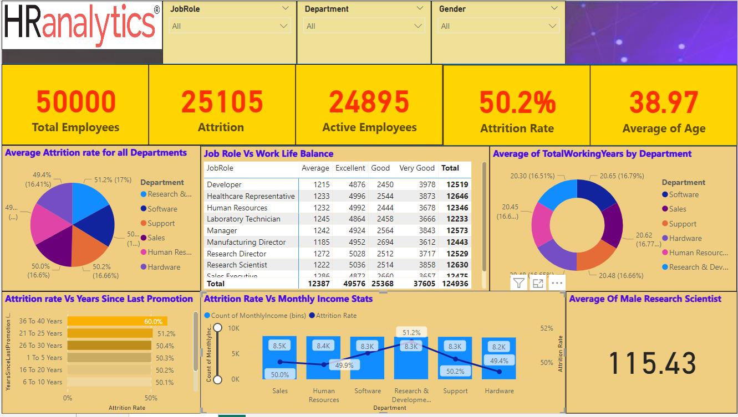

Slide 15
THANK YOU

